Slide 1

Finding Trends in Finding Forever Homes A data analysis and predictive model of foster care trends in The Midwestern United States
Project 3 | Group 7
Hannah Duncan | Geoffrey Johnston | Timothy O’Malley | Kristan Pruett | Ge (Melody) Yu
Notes:
Line spacing + Page numbers

Slide 2

Introduction
400,000.
A number so large, it is almost hard to fathom that many of any one thing.
A number that is downright staggering when paired with the following information:
“Each year, more than 400,000 children experience
foster care in the United States.”
-Voices for Children (www.speakupnow.org)

Slide 3

Introduction
Foster care in America is becoming more and more of a pressing issue on communities around the country. State agencies are becoming more and more saturated with children requiring foster care with not enough families to take in the children affected by separation.
Our goal is to be able to predict the future need of foster families in The Midwestern United States based on data obtained from 2010-2019.

Slide 4
Insert Melody’s Site
Notes:
Line spacing + Page numbers

Slide 5
Our Motivations
Get Geoffrey’s permission to share corner of the world tidbit!

Slide 6
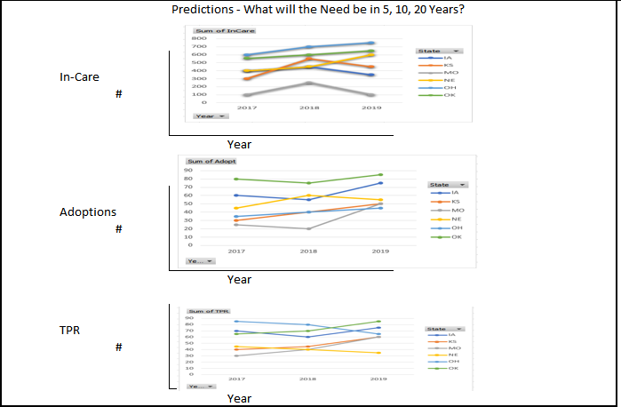
Our Predictions
Using a regression analysis from Sklearn we will develop a model to predict what the foster care needs will be in 5, 10, and 20 years from now. We will be looking at predicting the number of children in care as well as TPR predictions for the future (which can also be used to estimate group home needs for children that age out of the foster system without being adopted). We hope to be able to perform this prediction by state but may only be able to view the prediction in aggregate.
Notes:
Line spacing + Page numbers

Slide 7
Data Used
"Foster Trends in America”:
https://www.acf.hhs.gov/cb/resource/trends-in-foster-care-and-adoption
“Child Maltreatment 2011”
https://www.acf.hhs.gov/sites/default/files/documents/cb/cm11.pdf
“Voices for Children”
https://www.speakupnow.org/foster-care-statistics-resources/

Slide 8
The Info!

Slide 9
The Info!
Notes:
Line spacing + Page numbers

Slide 10
The Info!

Slide 11
Limitations and What Went Wrong
Data for each year just a snapshot on September 30th, not an average for that year
Negative r-squared issue/greater than 1

Slide 12
Additional Resources
How you can help: Donating | Volunteering | Fostering
KVC Kansas
KVC Kansas helps over 30,000 people annually through family preservation, family reunification, outpatient therapy, foster care, and adoption.
https://kansas.kvc.org/
DCCA
DCCCA provides social and community services that improve the safety, health, and well being of those we serve.
https://www.dccca.org/
Cornerstones of Care
We work to keep children safe and families together through education, foster care & adoption, mental & behavioral support, family services, youth services, and community trainings.
https://cornerstonesofcare.org/
Adopt US Kids
AdoptUSKids is a national project that supports child welfare systems and connects children in foster care with families.
https://www.adoptuskids.org/
Missouri Baptist Children’s Home
https://www.mbch.org/ministries-by-affiliate/the-light-house/5
Notes:
Line spacing + Page numbers

